Slide 1

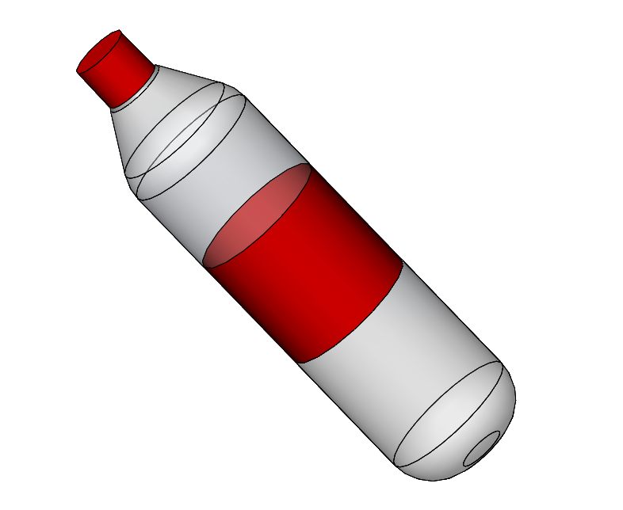
STI – robot competition
TEAM 3
Final presentation
Claudio Fritsche (GM)
Roman Oechslin (MT)
Héloïse Boross (MT)
Date of project:
20th March 2017

Slide 2
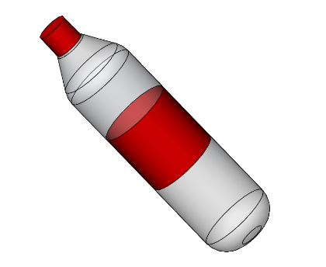
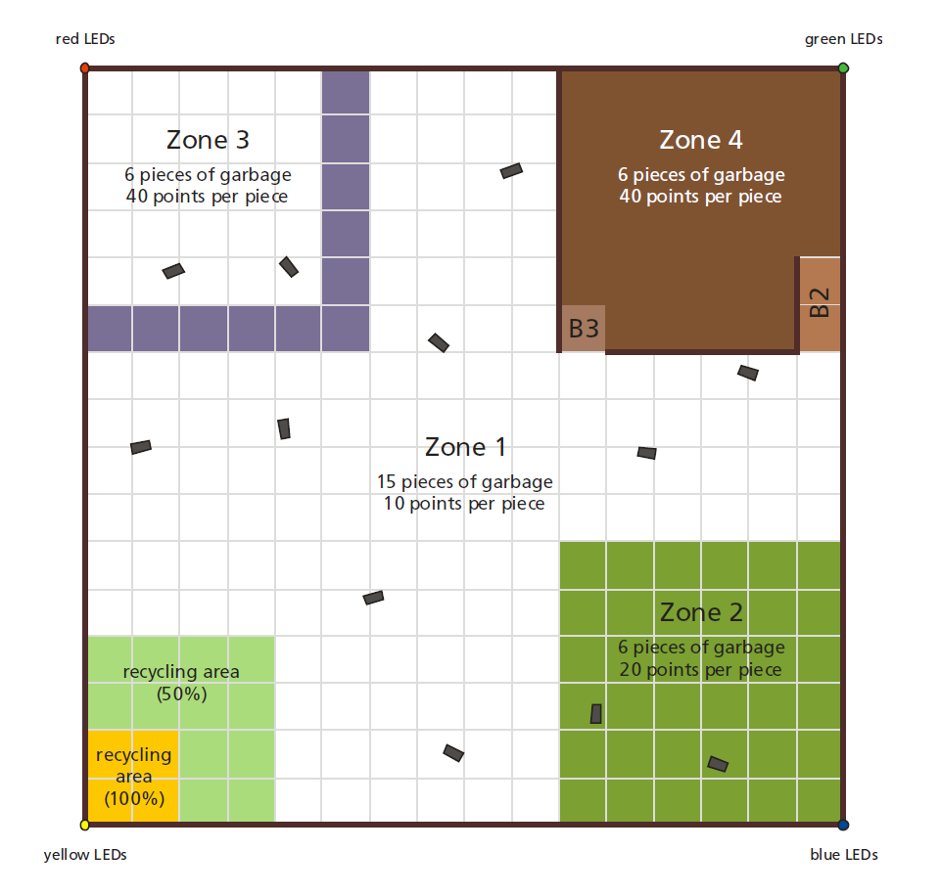
STI Competition
Requirements:
Autonomous
Collect and deposit bottles
Avoid obstacles
Computation must be done on-board
Must carry its power source
Must fit in 1m³
Specifications:
10 minutes
335’000\ budget
20h per week for 15 weeks
All terrain (grass, stones, carpet, ramp of 30°, stairs)
LED localization towers
Clearance of 50cm
2
Introduction HW mechanics HW electronics Budget Software Management

Slide 3
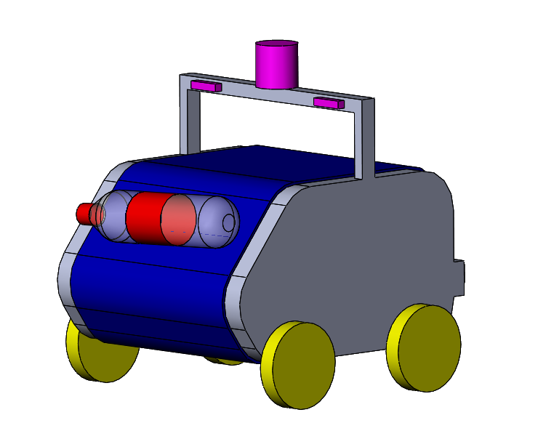
Concept
3
Introduction HW mechanics HW electronics Budget Software Management

Slide 4
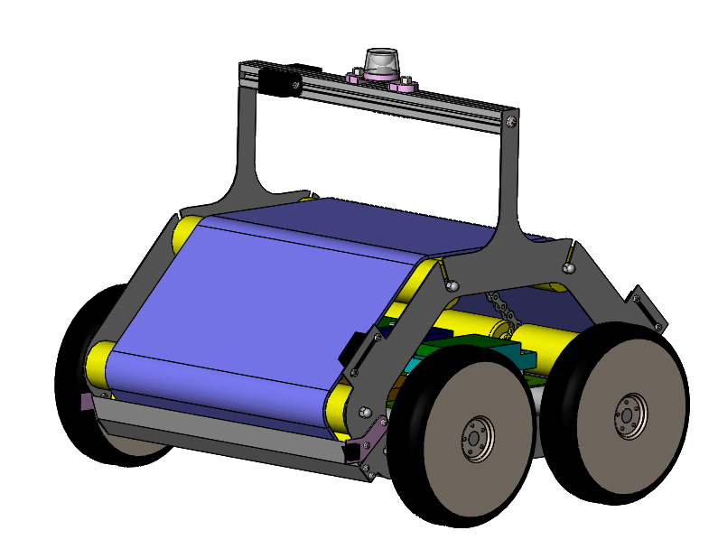
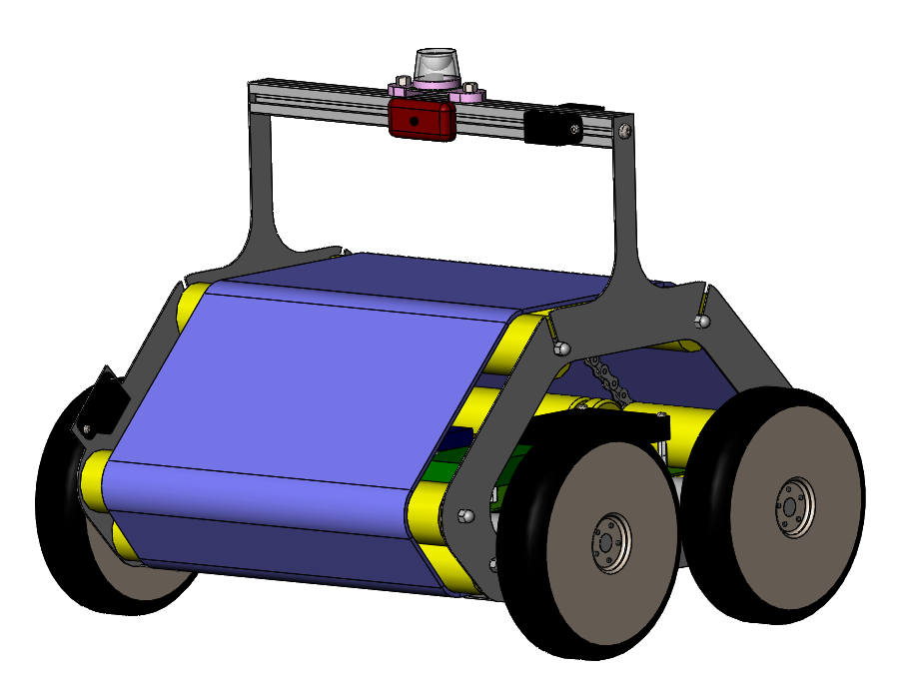
Outside of the robot
Camera
360° camera
6 x IR sensors
FRONT
Sticky conveyor belt
BACK
Bottle releaser
2x Bumpers
Aeration and access hole
4
Introduction HW mechanics HW electronics Budget Software Management

Slide 5
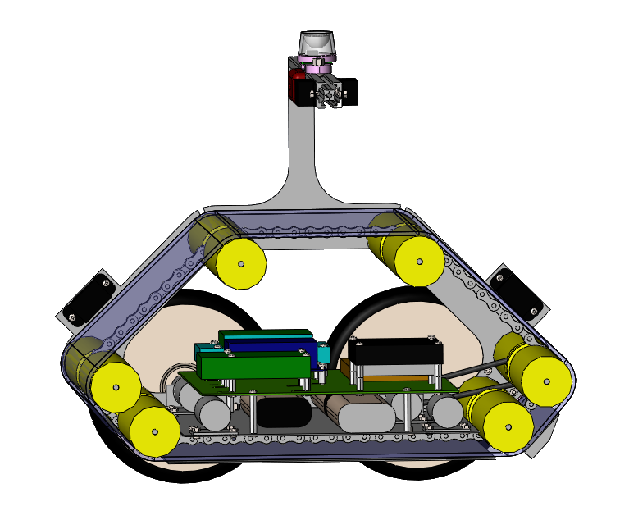
Inside of the robot
Roller
Electronics
5x Motors
2x Batteries
5
Introduction HW mechanics HW electronics Budget Software Management

Slide 6
Dimensions
97 mm
362 mm
250 mm
110 mm
300 mm
31 mm
38 mm
375 mm
419 mm
6
Introduction HW mechanics HW electronics Budget Software Management

Slide 7
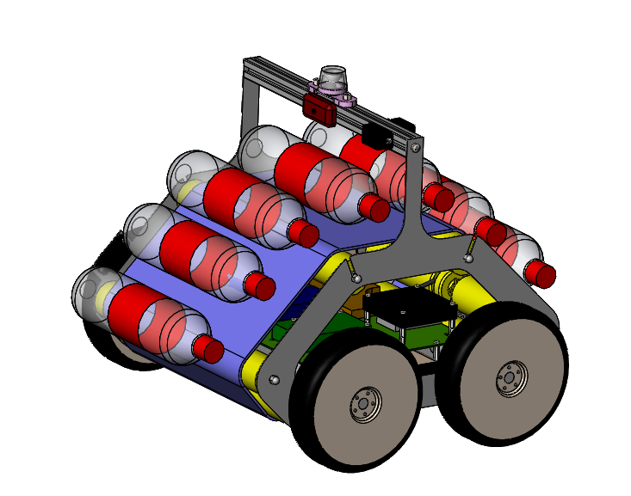
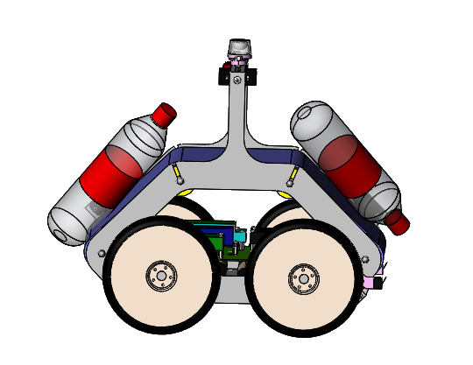
Expected capability
from 2 to 7 bottles
7
Introduction HW mechanics HW electronics Budget Software Management

Slide 8
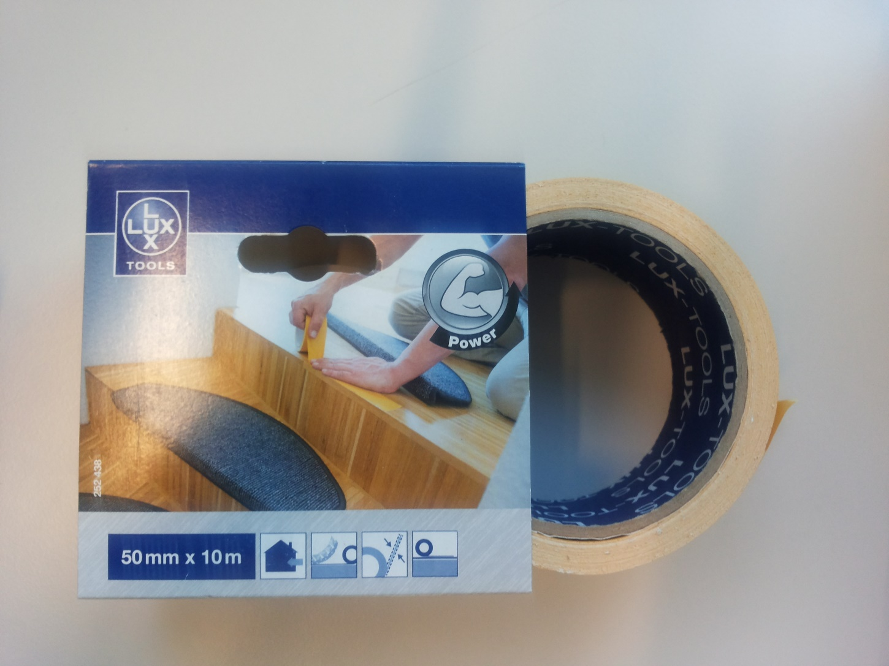
Sticky material
Two sided duct tape
Robust to vibration
Good repeatability
Robust to dust
Cheap solution
8
Introduction HW mechanics HW electronics Budget Software Management
How to fix it? (explain)
2-Faces tape

Slide 9
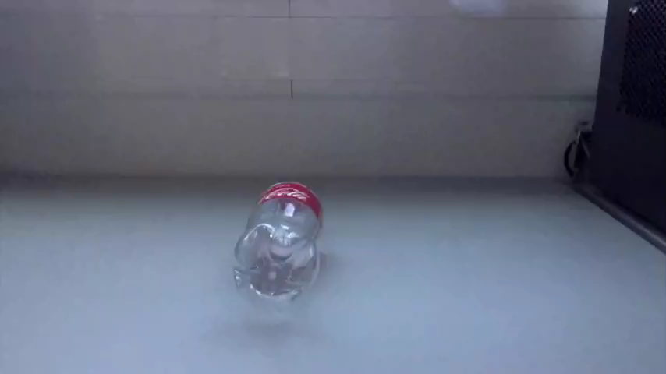
Sticky material testing
9
Introduction HW mechanics HW electronics Budget Software Management

Slide 10
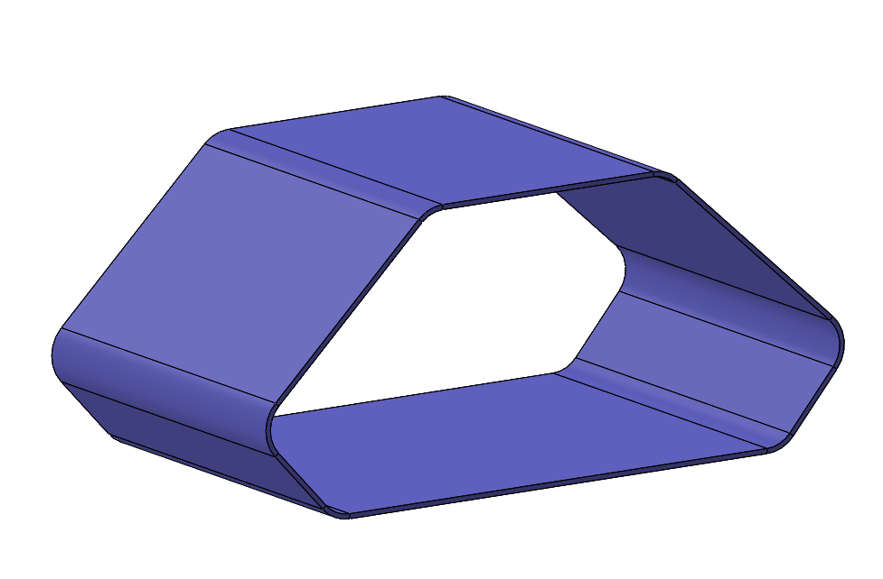
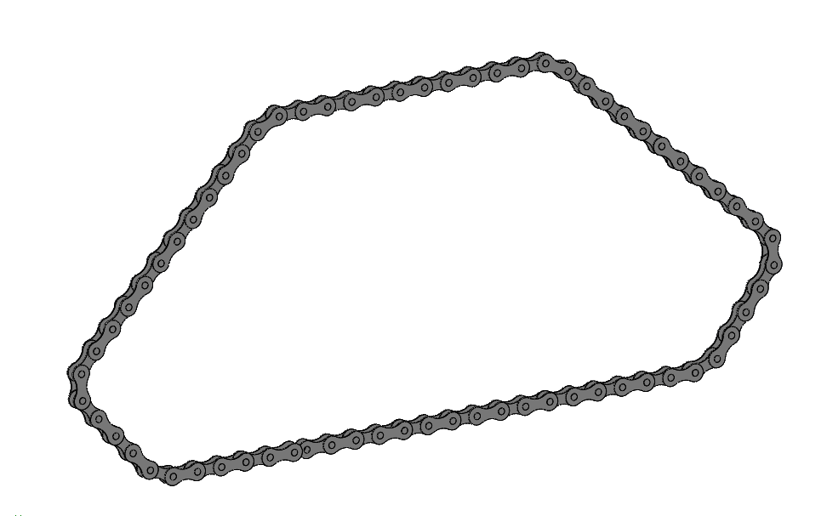
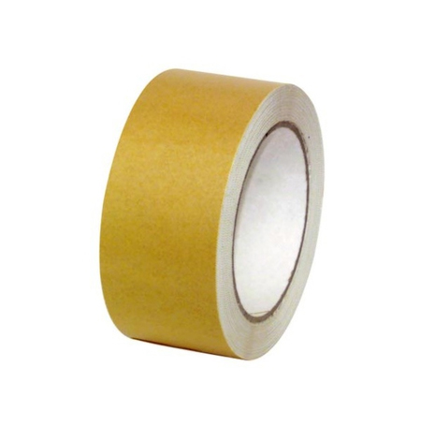
Sticky belt fabrication
Sewing
Taping
10
Introduction HW mechanics HW electronics Budget Software Management

Slide 11
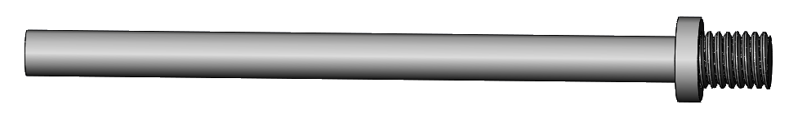
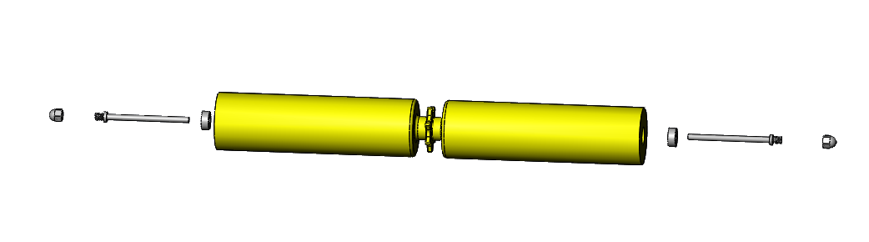

Roller
Axle
Ball bearing
FREE AXLE
Round-head nut
Sides of the robot
ACTUATED AXLE
11
Introduction HW mechanics HW electronics Budget Software Management

Slide 12
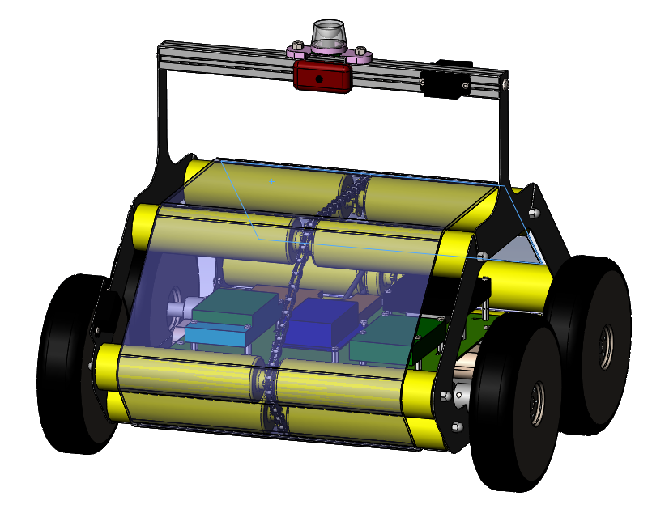
Conveyoring
Smooth belt
Chain
1 Motor
12
Introduction HW mechanics HW electronics Budget Software Management

Slide 13
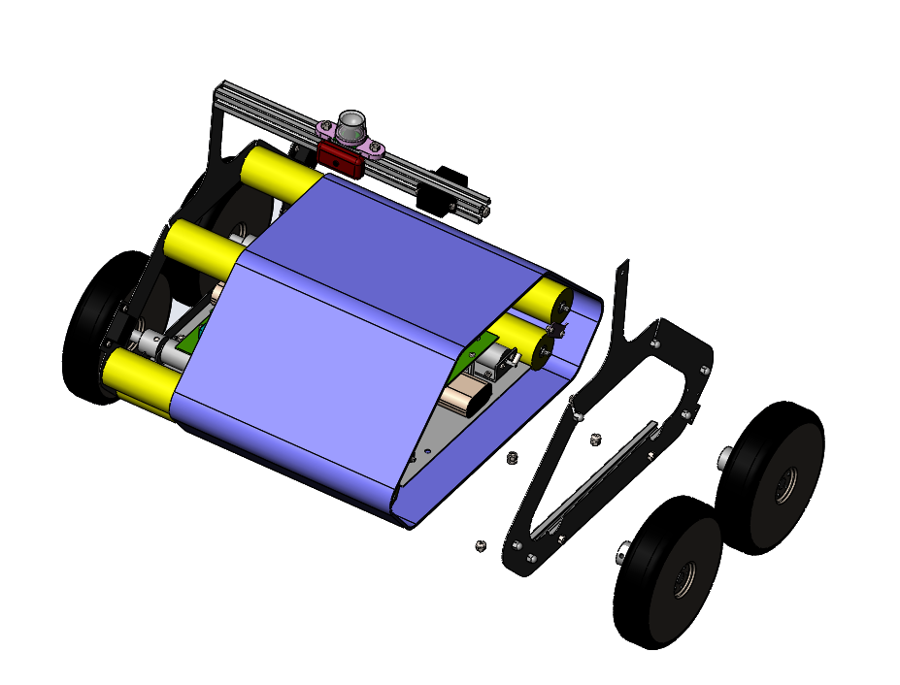
Assembly
Changing the conveyor belt
2 screws for wheels
11 screws for the plate
The sticky belt (already attached on the chain) is slided on the rollers
13
Introduction HW mechanics HW electronics Budget Software Management

Slide 14
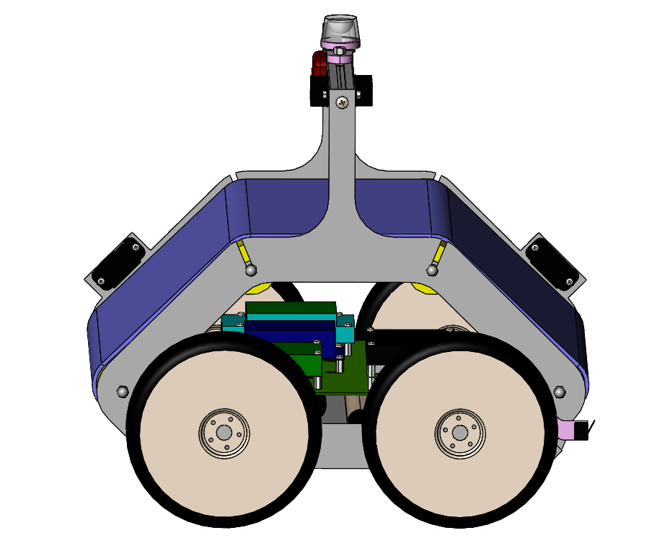
Adjustments
Tension in the sticky belt
Moving the axles of the rollers
Held with screws
14
Introduction HW mechanics HW electronics Budget Software Management

Slide 15
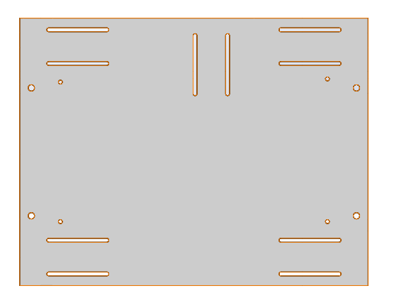
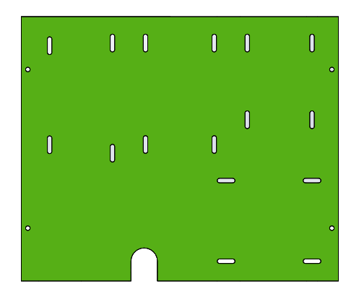
Adjustments
MOTOR PLATE
There were some unknown dimensions of components
Adjustable positions of motors
STRATEGY
Oblong holes
PCB PLATE
15
Introduction HW mechanics HW electronics Budget Software Management

Slide 16
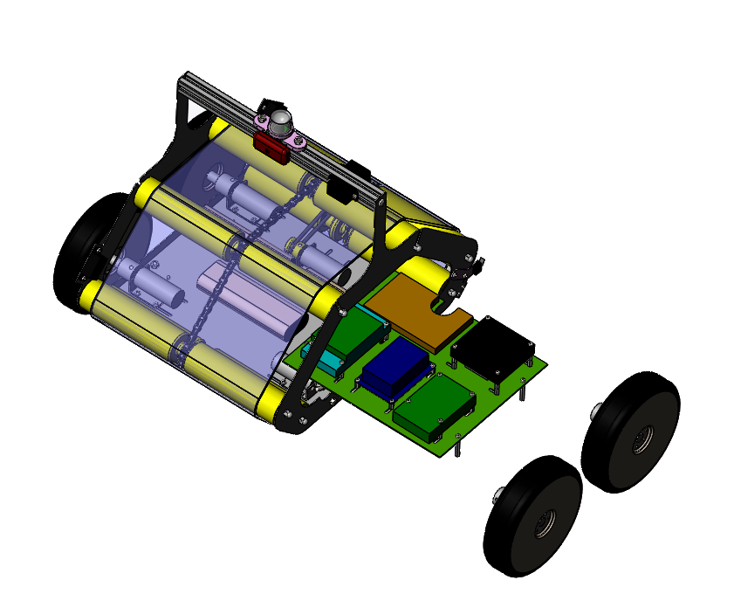
Assembly
Removing the electronics
2 screws for wheels
4 screws for the PCBs
The PCB has to be electrically disconnected from the batteries which remain in the robot
16
Introduction HW mechanics HW electronics Budget Software Management

Slide 17
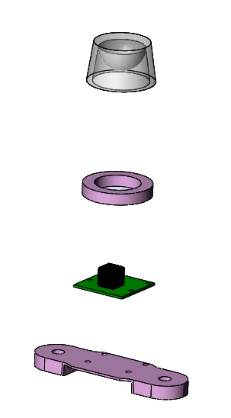

Mechanical components
360° mirror
3D printing
Raspberry camera
3D printing
17
Introduction HW mechanics HW electronics Budget Software Management

Slide 18
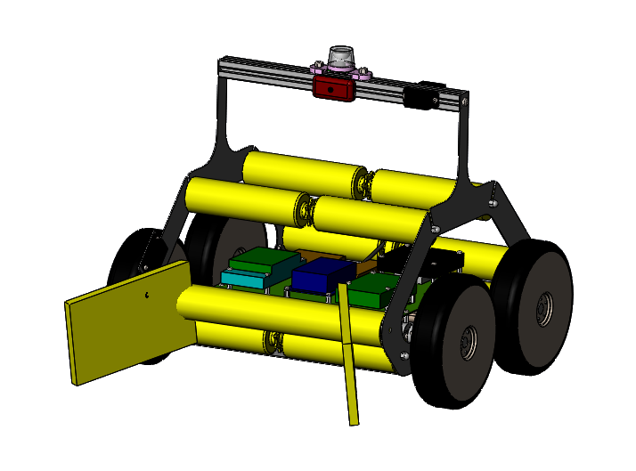
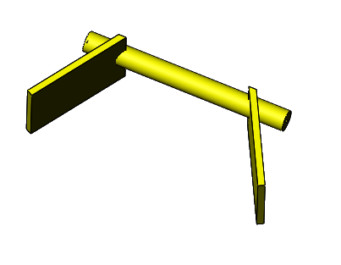
Backup plan
18
Introduction HW mechanics HW electronics Budget Software Management

Slide 19
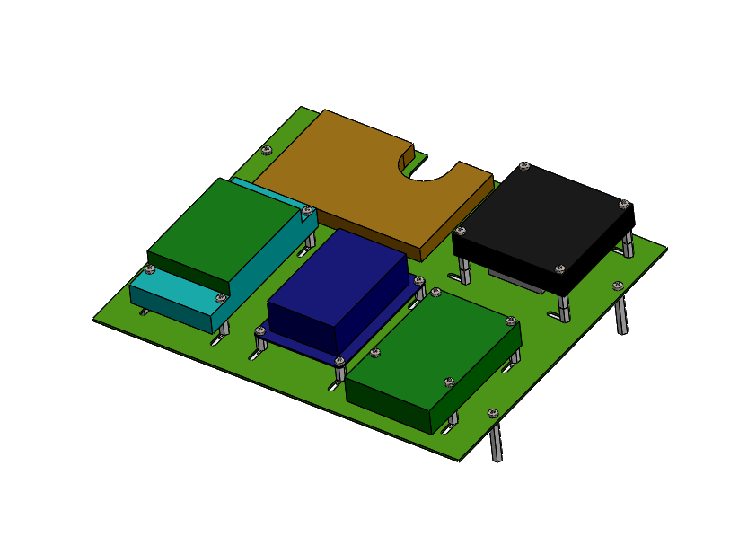
Electronic assembly
PCB components
DF Motor Driver
Raspberry Pi
Arduino and Arduone
Odroid
19
Introduction HW mechanics HW electronics Budget Software Management

Slide 20
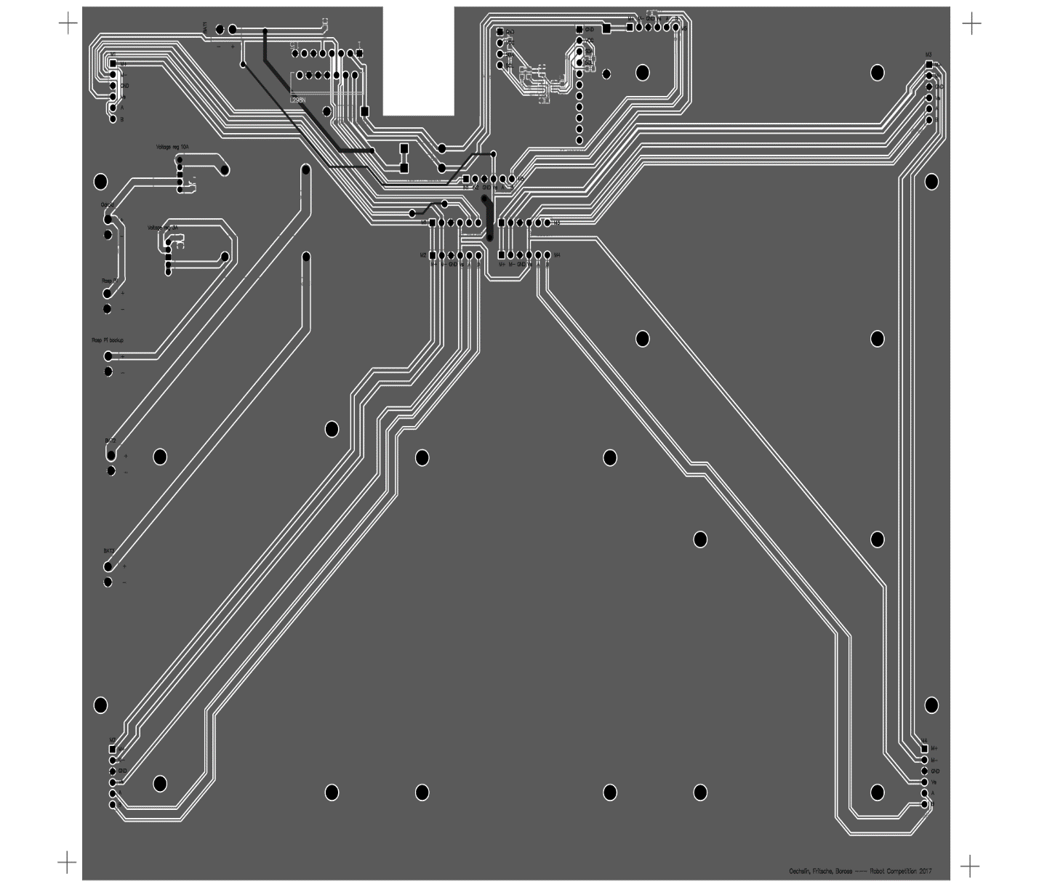
PCB plate – altium designer
Motor driver
IMU and voltage level shift
DCDC converters
Battery connector
Motor outlets
20
Introduction HW mechanics HW electronics Budget Software Management

Slide 21
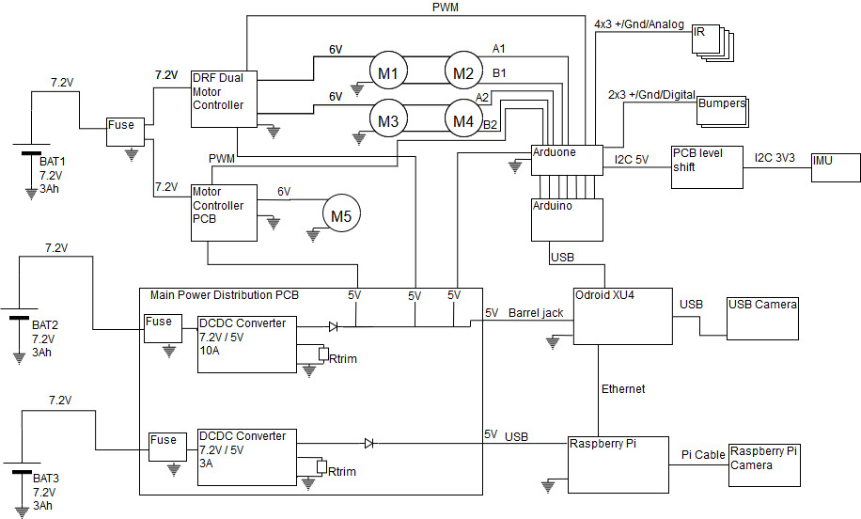
Electrical design
21
Introduction HW mechanics HW electronics Budget Software Management

Slide 22
Power budget
 | Part | Vcc [V] | Current [A] | Total consumption [W]
4 | Motors (Wheels) | 6 | 2.4 | 57.6
1 | Motor Conveyor | 6 | 2.4 | 14.4
1 | Raspberry Pi | 5 | 2.5 | 12.5
1 | Raspberry Camera | 5 | 0.25 | 1.25
1 | Odroid | 5 | 4 | 20
1 | USB camera | 5 | 0.15 | 0.75
1 | Arduino | 12 | 0.1 | 1.2
1 | Arduone | 12 | 0.1 | 0.6
10 | Sensors | 5 | 0.05 | 2.5
Margin 50% |  |  |  | 55.4
Total |  |  |  | 162.2
Runtime 20min at 6V |  |  | 9200mAh
22
Introduction HW mechanics HW electronics Budget Software Management

Slide 23
Electrical components
Processing | Sensing and Actuation | Miscellaneous
Arduino + Arduone | 5x Motor w/ encoders | 3x Battery
Raspberry Pi | Raspberry Camera | Dual H-bridge
Odroid (+eMMC) | USB Camera | 2x DC converters
 | 2x Bumpers | H-bridge motor driver
 | IMU | Cables and Connectors
 | 6x IR sensors | Resistors, Capacitances and Regulators
23
Introduction HW mechanics HW electronics Budget Software Management

Slide 24
Budget management
24
Introduction HW mechanics HW electronics Budget Software Management

Slide 25
Communication schematics
Odroid
Command to move to point (x,y), low frequency
Communication:
ROS Jade
30 fps
B_{x}, B_{y},
Distance
Low frequency
USB
Cam
RPI
II
Commands
Bool: stock
Ardu-ino
High frequency signals
30 fps
Pmw, high f
RPI
Cam
Motor Driver 1
Motor Driver 2
IMU
IR
5x
Encoder
Bumpers
M1
M1
M1
M1
M1
25
Introduction HW mechanics HW electronics Budget Software Management

Slide 26
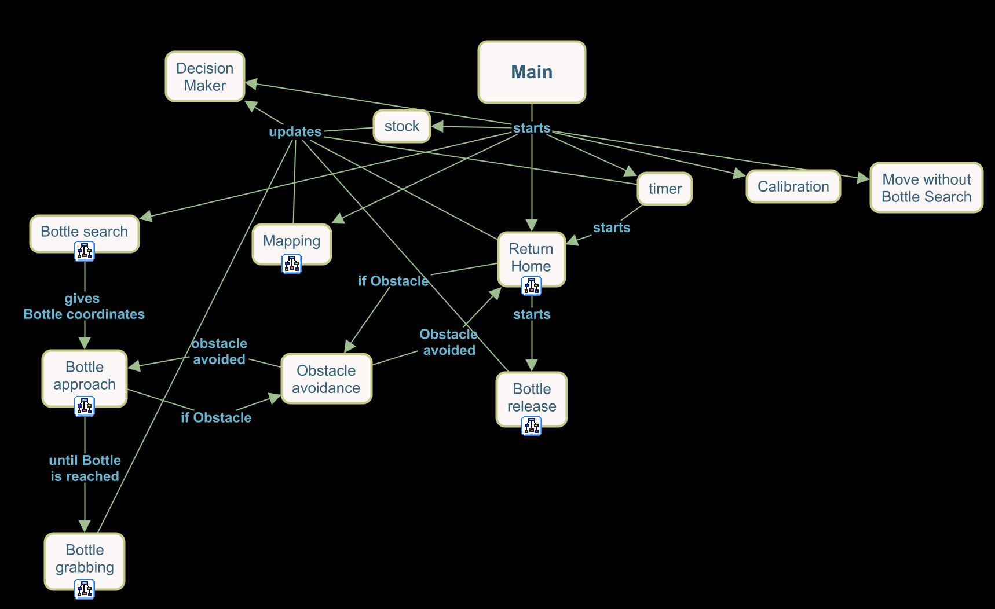
Software architecture
26
Introduction HW mechanics HW electronics Budget Software Management

Slide 27
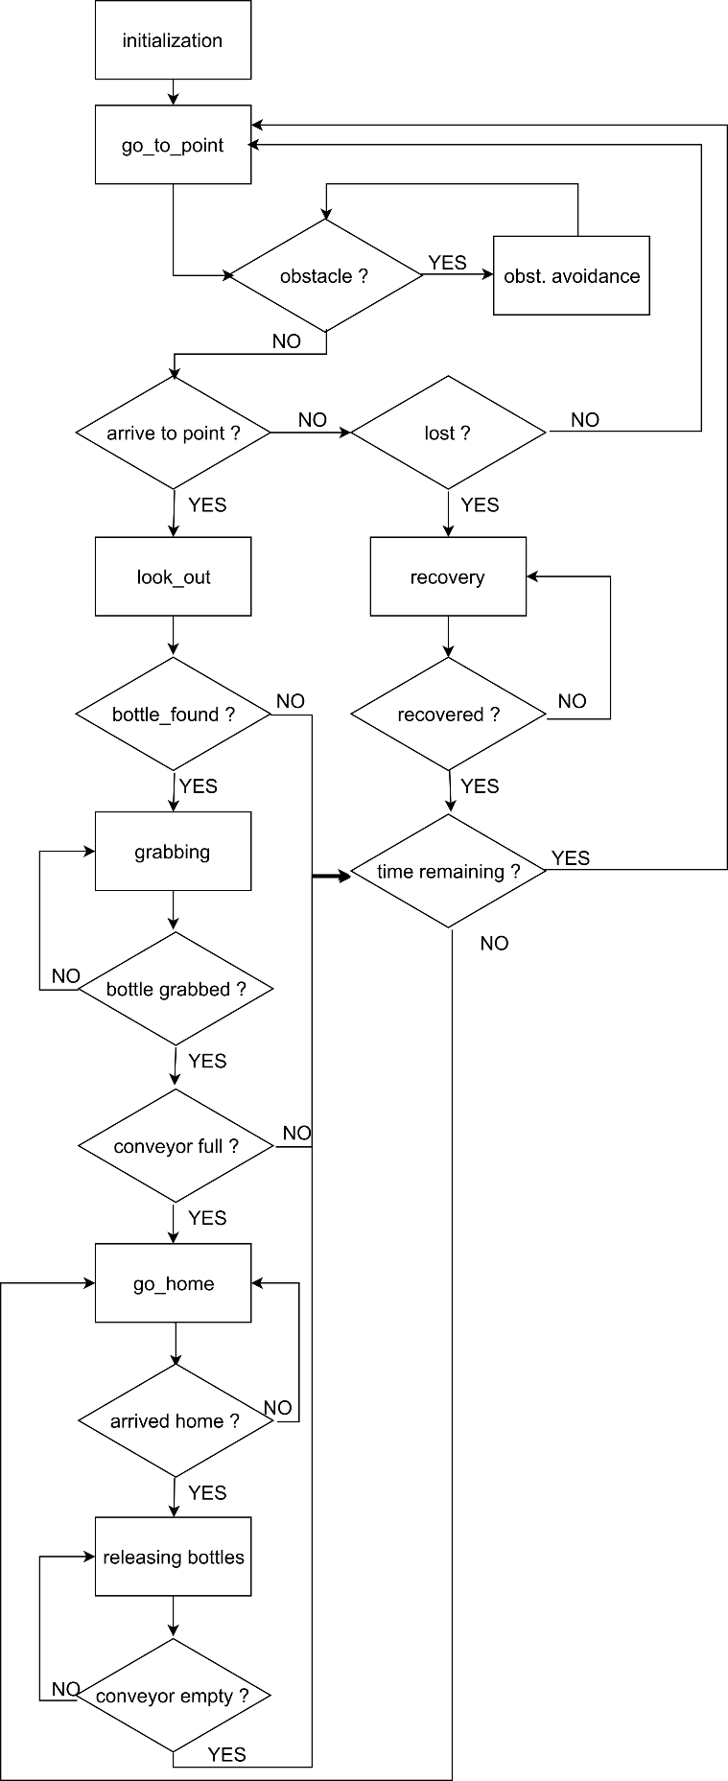


Software architecture
27
Introduction HW mechanics HW electronics Budget Software Management

Slide 28
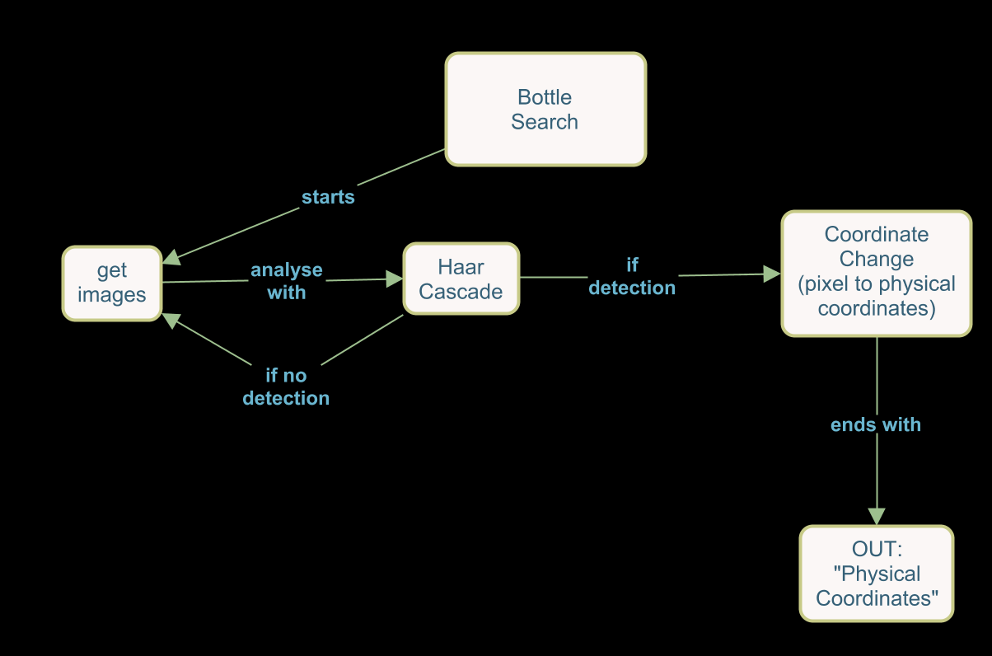
Bottle detection
Results
28
Introduction HW mechanics HW electronics Budget Software Management

Slide 29
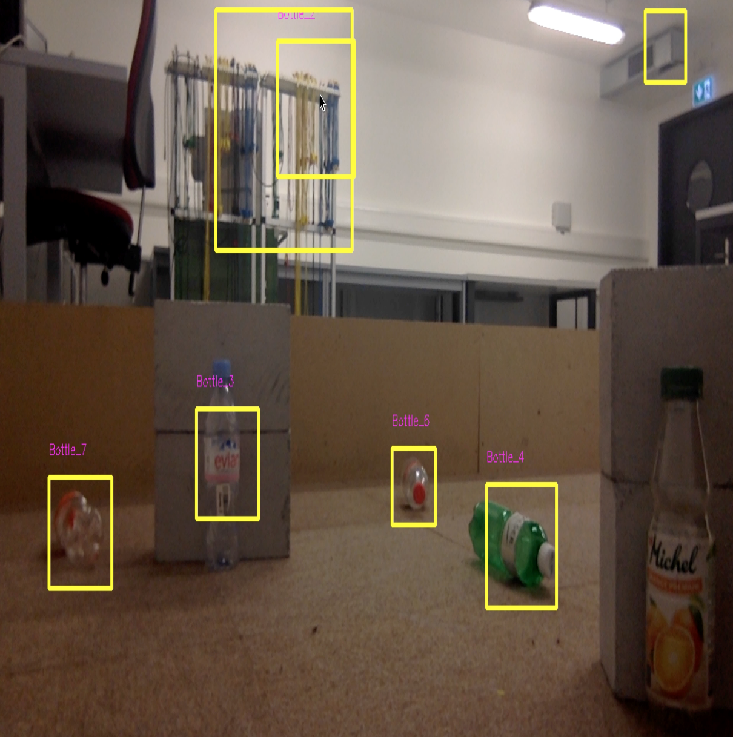
Bottle detection
Results
29
Introduction HW mechanics HW electronics Budget Software Management

Slide 30
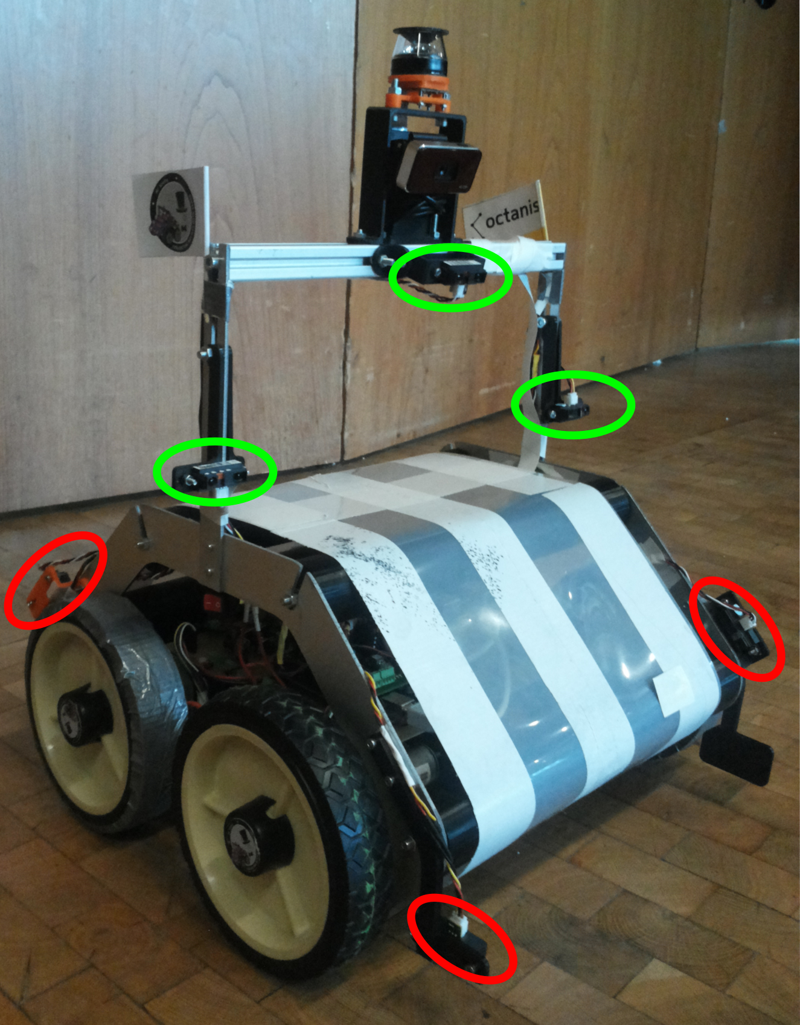
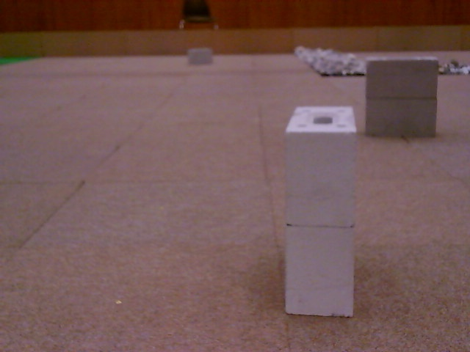
Obstacle avoidance
30
Introduction HW mechanics HW electronics Budget Software Management

Slide 31
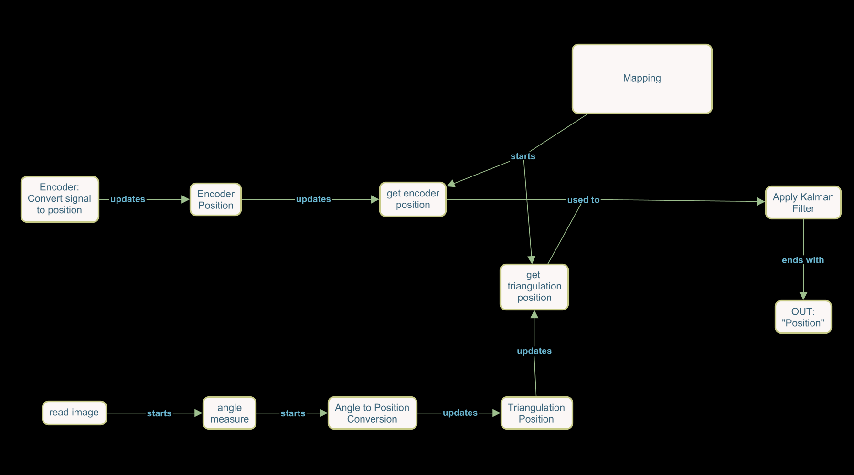
Localization
31
Introduction HW mechanics HW electronics Budget Software Management

Slide 32
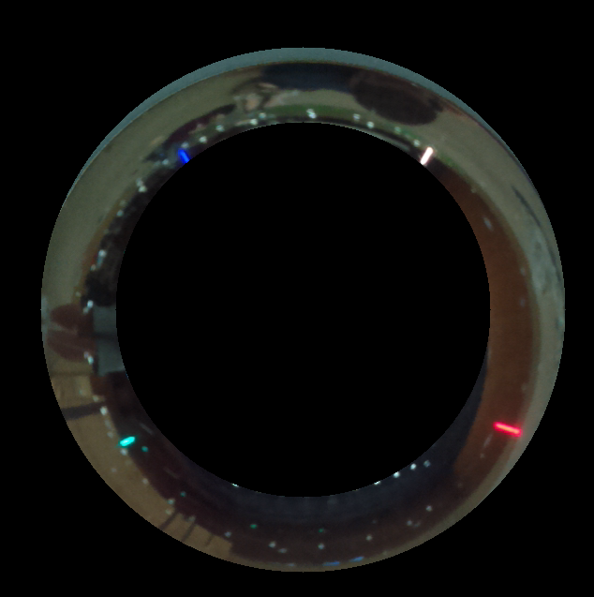
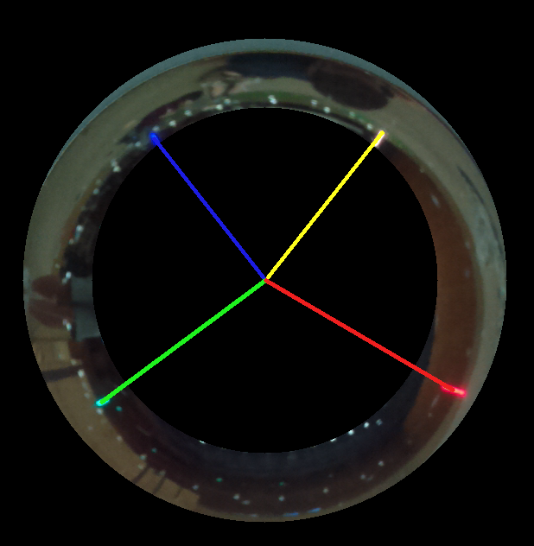
Localization
32
Introduction HW mechanics HW electronics Budget Software Management

Slide 33
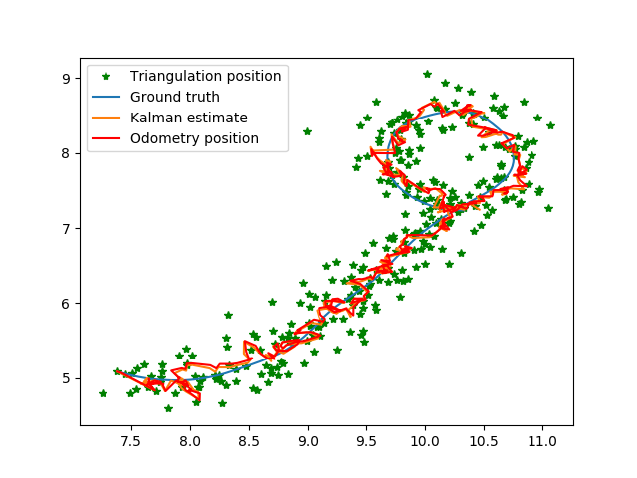
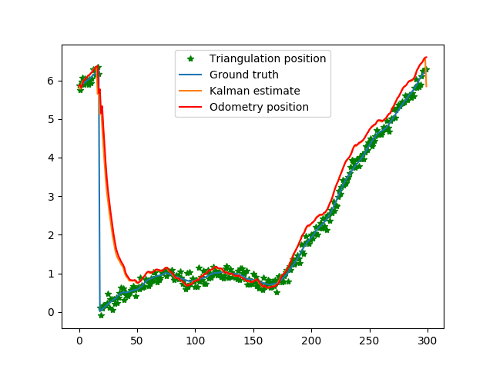
Localization – Kalman filter
33
Introduction HW mechanics HW electronics Budget Software Management

Slide 34
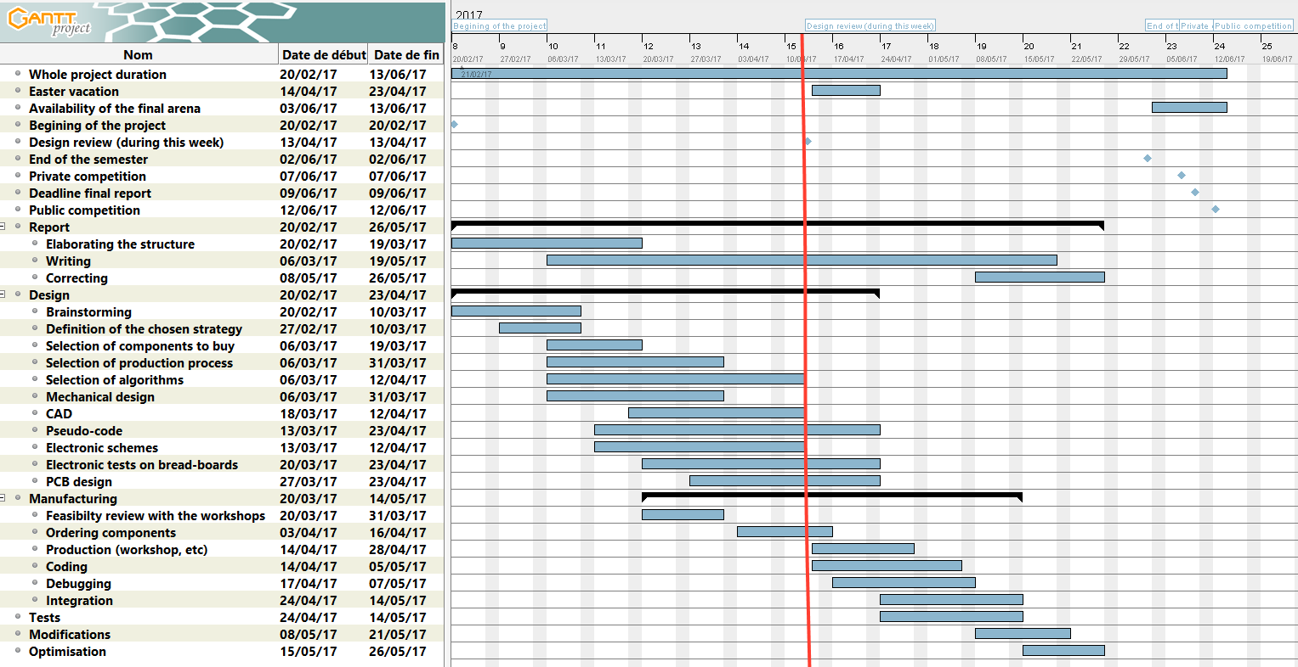
Time management
34
Introduction HW mechanics HW electronics Budget Software Management

Slide 35
Tasks management
ACHIEVED TASKS
CURRENT DISTRIBUTION
FUTURE TASKS
Mechanical Design
Electronical Design
Software architecture
Corrections of the mechanical design
Production of mechanical parts
Ordering of mechanical parts
Prototype of the electrical design
PCB production
Ordering of electrical parts
Computer Vision
Coding
Report Writing
Building the robot
Tests
Optimisation
35
Introduction HW mechanics HW electronics Budget Software Management

Slide 36
Tools – retrospective
Tools used | Used for | Recommendation
Git | Code organization (version control) | +++ (absolute must)
ROS | Robotic Middleware | +++ (Powerful, but difficult)
Overleaf | Shared report writing | ++
Wunderlist | Task management | ++ (easy to use, helps in organization)
SolidWorks | Design | +
AltiumDesigner | PCB design | 0 (difficult, but useful)
Gantt | Time management | - (not really necessary)
36
Introduction HW mechanics HW electronics Budget Software Management

Slide 37
Lessons learned – key points
Communication within group
Testing
Keep working project branch
Evaluation of results
Think about a backup strategy
37
Introduction HW mechanics HW electronics Budget Software Management

Slide 38
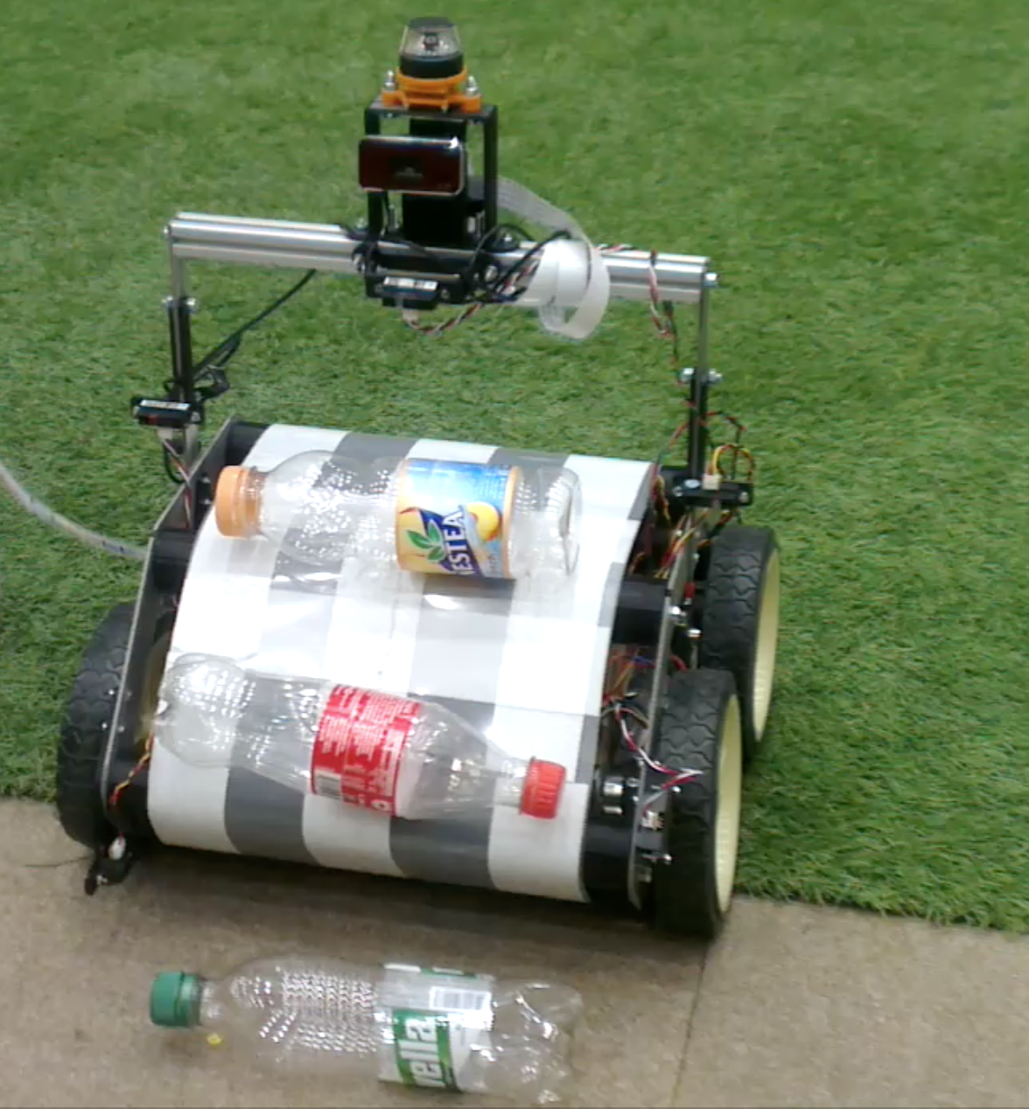
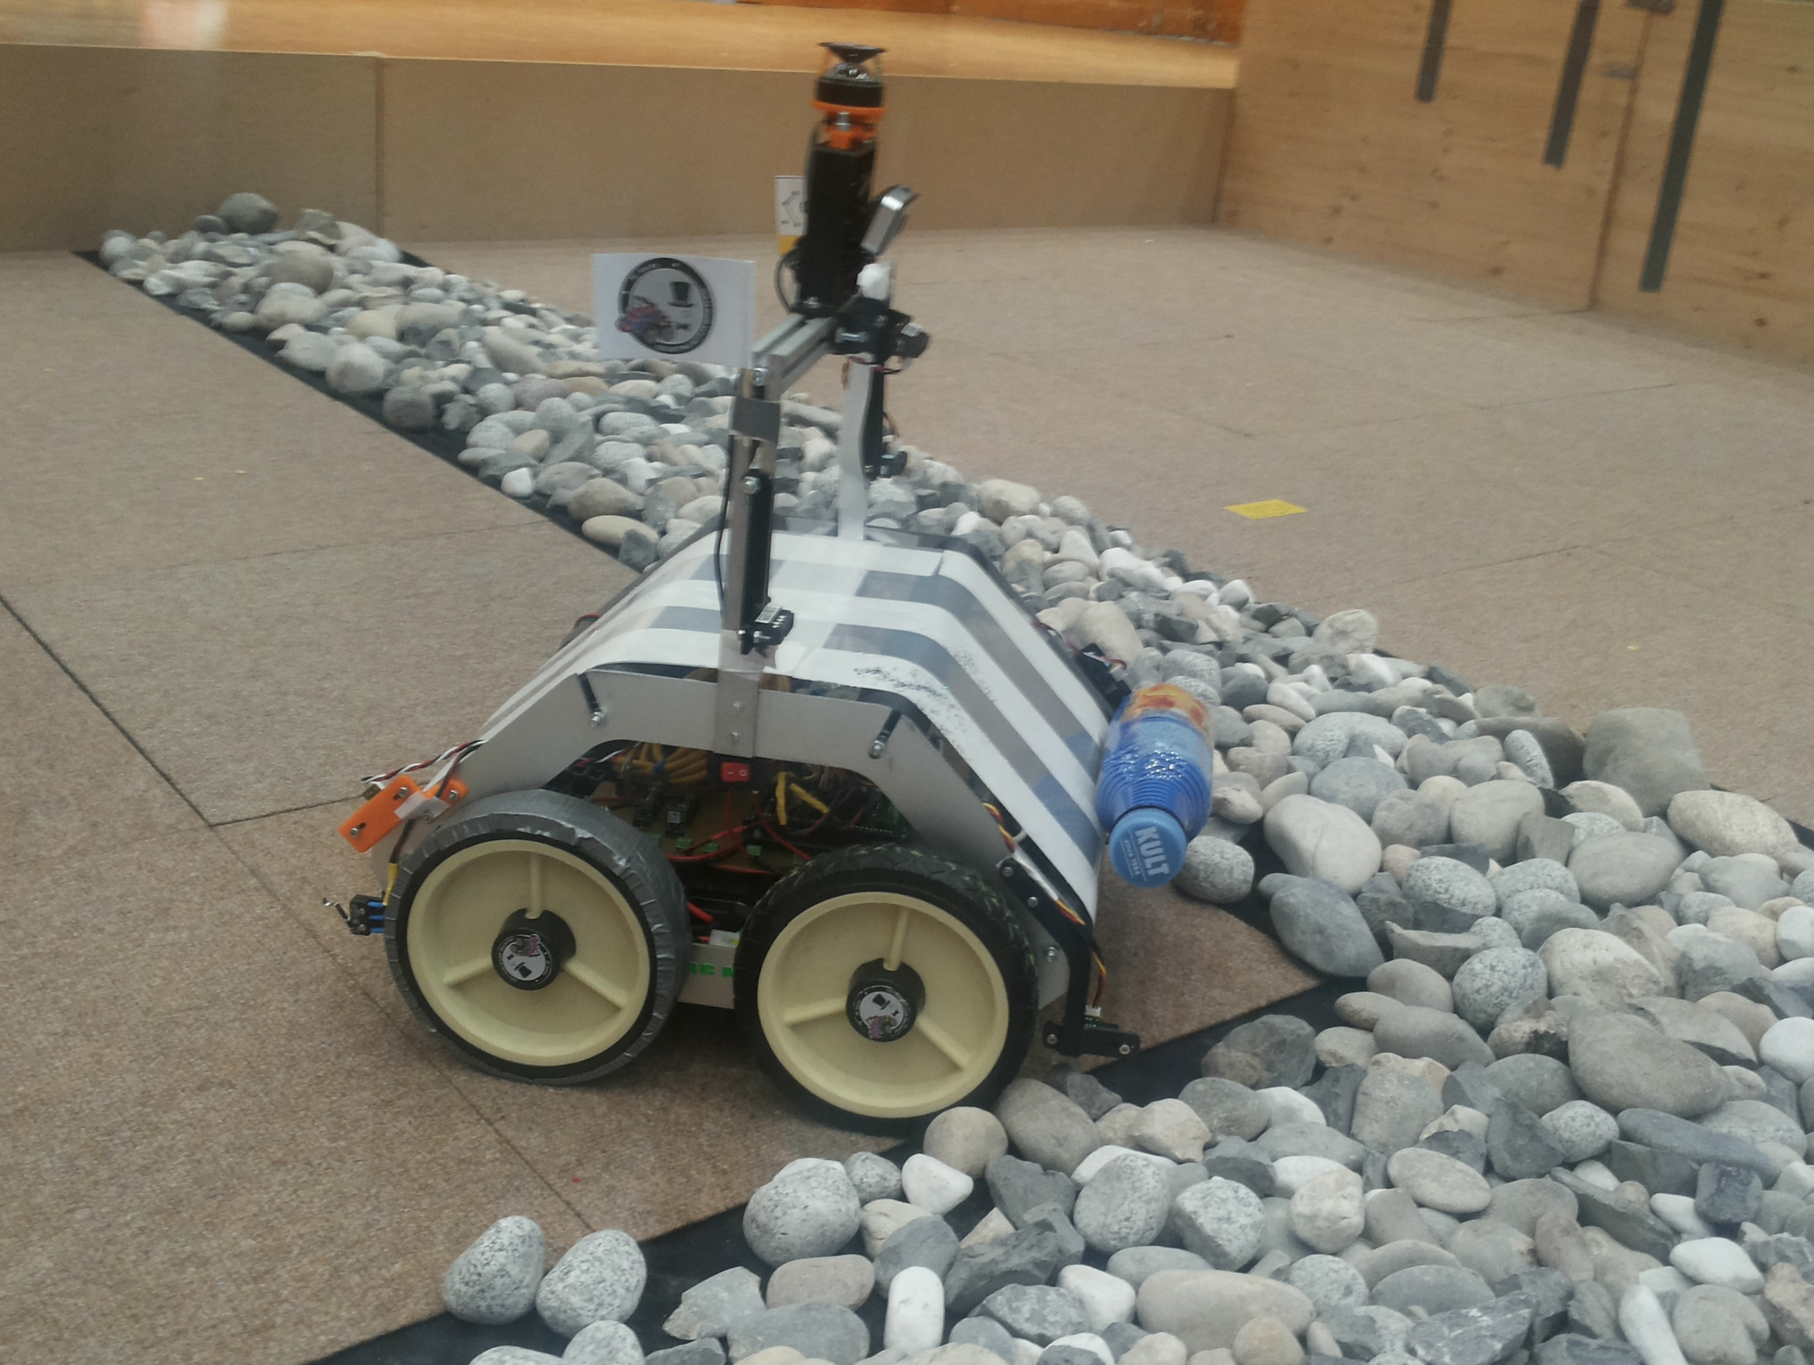
Final result
38
Introduction HW mechanics HW electronics Budget Software Management

Slide 39
Thank you for your attention
Notes:
Questions?

